Slide 1

Practical Reproducible Evaluation of Computer Systems
Ivo Jimenez, Michael Sevilla, Noah Watkins,
Sina Hamedian, Pete Wilcox, Carlos Maltzahn,
Jay Lofstead, Kathryn Mohror, Adam Moody,
Andrea Arpaci-Dusseau, Remzi Arpaci-Dusseau

Slide 2
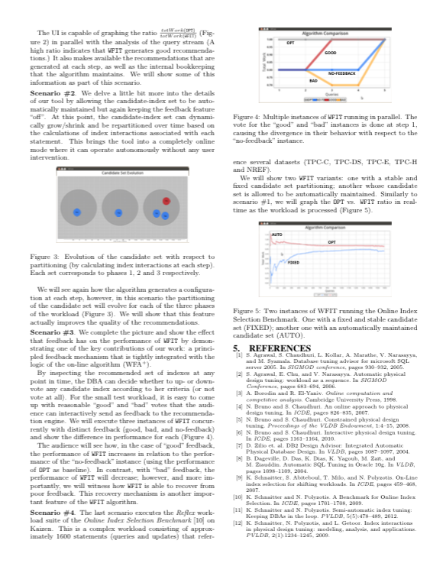
Problem of Reproducibility in Computation and Data Exploration
What compiler was used?
Which compilation flags?
How was subsystem X configured?
How does the workload look like?
What parameters can be modified?
What if I use input dataset Y?
And if I run on platform Z?
…
Notes:
To motivate the discussion about why we need an experimentation protocol, let me go over a scenario I’m sure many of you have experienced
And at this point, one would like to have..

Slide 3
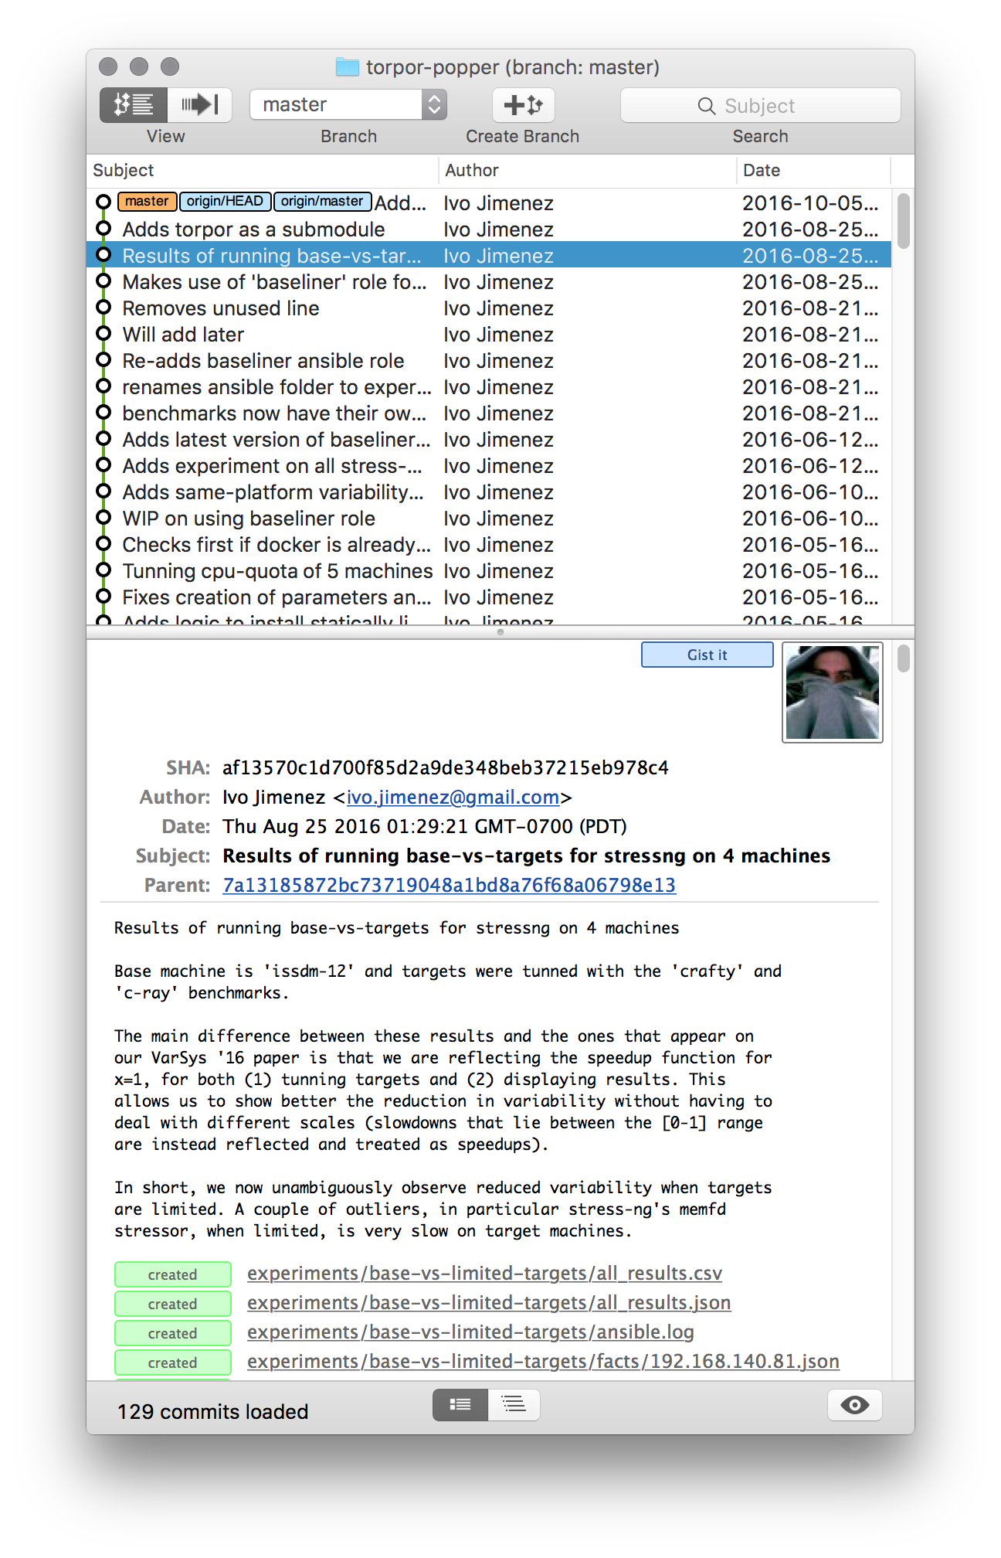
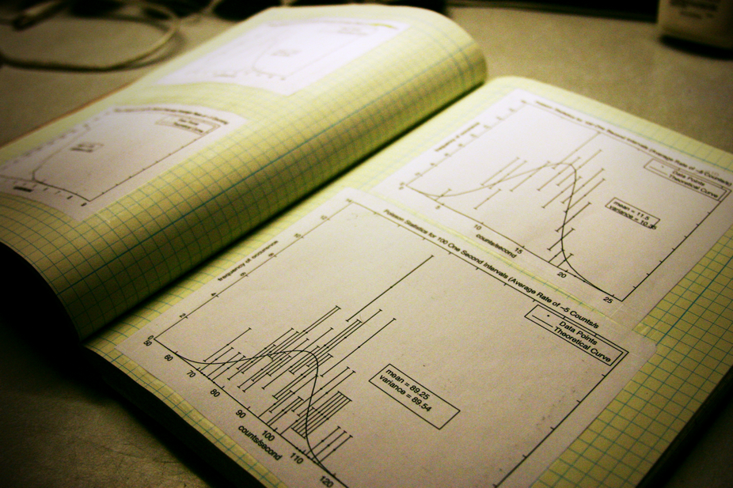
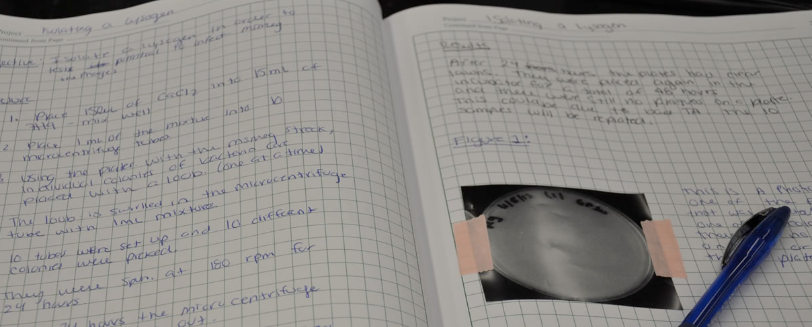
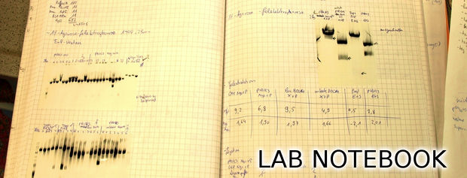
Lab Notebook
Notes:
In some sense, one would want to have the equivalent of what researchers in experimental sciences have: the lab notebook to document my experiment.
If our experiments are mostly code, then one way to look at this is as if we had the source code (of the EXPERIMENT) and a log (the commit log) detailing the evolution of the experiment over time
But just putting all the experiment’s artifacts in a version control system doesn’t make an experiment

Slide 4
End-to-end Scientific Experimentation Pipelines
observation or simulation
data cleaning
and processing
data analysis
output data
and visualization
Manage Code
Data Mgmnt
Analyze/
Visualize
Build and Package
Execute
Manuscript
Notes:
At each of these stages, we might need to write, manage, maintain, package code/data/documentation . We might need to also report results in a form of manuscripts

Slide 5
Analogies With Modern SE Practices (aka DevOps)
Scientific exploration | Software project
Experiment code | Source code
Data management | Test examples
Analysis / visualization | Test analysis
Validation | CI / Regression testing
Manuscript / notebook | Documentation / reports
Key Idea: manage a scientific exploration like software projects

Slide 6




















DevOps View of The Experimentation Pipeline
SciOps
observation or simulation
data cleaning
and processing
data analysis
output data
and visualization
Manage Code
Data Mgmnt
Analyze/
Visualize
Build and Package
Execute
Manuscript

Slide 7
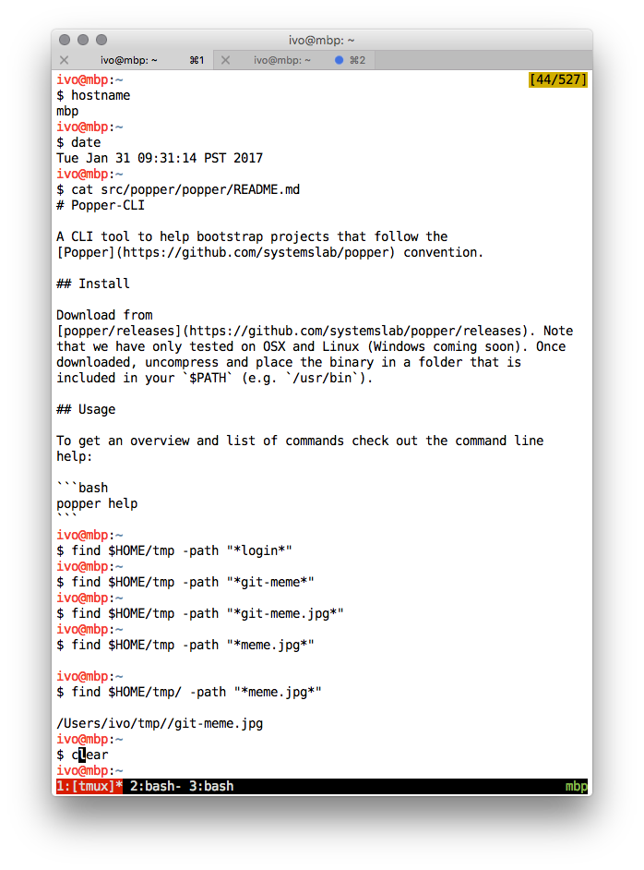


What is DevOps?
Typical
DevOps
myscript.sh
$ bash myscript.sh

Slide 8

The Popper Convention
Pick one or more tools from the DevOps toolkit
Write scripts for an experiment pipeline
Put all scripts in a version control repository
[1]: Jimenez et al. Standing on the Shoulders of Giants by Managing Scientific Experiments Like Software, ;login: Winter 2016, Vol. 41, No. 4.
[2]: Jimenez et al. The Popper Convention: Making Reproducible Systems Evaluation Practical, REPPAR 2017.
Notes:
Upfront, at the beginning of the exploration, otherwise is costly to do it at the end

Slide 9

Popper CLI tool
Make it super easy to automate execution and validation of experimentation pipelines
easy → low-overhead → more likely it’ll be used
Common convention to organize the contents of a repo
CLI tool that helps users to implement pipeline stages
Provide domain-specific examples
Today: Genomics, MPI, Ceph, Athmospheric Science
Working with domain-experts to contribute more examples

Slide 10
mypaper/
├── pipelines
│ ├── generate-data
│ │ ├── README.md
│ │ ├── output
│ │ │ ├── exp1.csv
│ │ │ ├── post.sh
│ │ │ └── view.ipynb
│ │ ├── run.sh
│ │ ├── setup.sh
│ │ ├── teardown.sh
│ │ └── validate.sh
│ ├── analysis1
│ │ ├── README.md
│ │ └── ...
│ └── analysis2
│ ├── README.md
│ └── ...
└── paper
├── build-pdf.sh
├── figures/
├── paper.tex
└── refs.bib
Common convention to organize the contents of a repo

Slide 11
$ cd my-paper-repo
$ git init
Initialized empty Git repository in my-paper-repo/.git
$ popper init
Initialized popper repository.
$ popper pipeline init mypipeline --stages=prepare,execute,cleanup
-- Initialized exp1 pipeline.
$ ls -l pipelines/mypipeline
total 20K
-rw-r----- 1 ivo ivo 8 Apr 29 23:58 README.md
-rwxr-x--- 1 ivo ivo 210 Apr 29 23:58 execute.sh
-rwxr-x--- 1 ivo ivo 206 Apr 29 23:58 prepare.sh
-rwxr-x--- 1 ivo ivo 61 Apr 29 23:58 cleanup.sh
CLI tool
#!/bin/bash
# request remote resources
docker run google/cloud-sdk gcloud init
...
#!/bin/bash
# trigger execution of experiment
docker run google/kubectl run ...
...

Slide 12




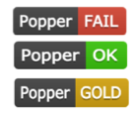



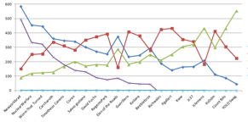
mypaper/pipelines/exp1
├── ansible/
│ ├── ansible.cfg
│ ├── machines.txt
│ └── playbook.yml
├── docker/
│ ├── Dockerfile
│ └── entrypoint.sh
├── enos/
│ └── reservation.yml
├── results/
│ ├── figure1.png
│ ├── postprocess.py
│ └── visualize.ipynb
├── run.sh
├── setup.sh
├── teardown.sh
├── validate.sh
└── vars.yml
provider:
type: chameleonbaremetal
image_name: CC-Ubuntu14.04-Docker
subnet: {name: shared-subnet1}
walltime: '00:30:00'
resources:
storage:
compute: 10
docker run --rm \
-e OS_AUTH_URL=$OS_AUTH_URL \
-e OS_TENANT_ID=$OS_TENANT_ID \
-e OS_TENANT_NAME=$OS_TENANT_NAME \
-e OS_PROJECT_NAME=$OS_PROJECT_NAME \
-e OS_USERNAME=$OS_USERNAME \
-e OS_PASSWORD=$OS_PASSWORD \
-e OS_KEYNAME=$OS_KEYNAME \
-v `pwd`/enos:/enos \
--workdir=/enos \
ivotron/enos:2.3.0 up

Slide 13
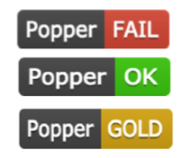
$ popper run exp1
Popper run started
Stage: setup.sh .....
Stage: run.sh ................
Stage: validate.sh .
Stage: teardown.sh ...
Popper run finished
Status: OK

Slide 14
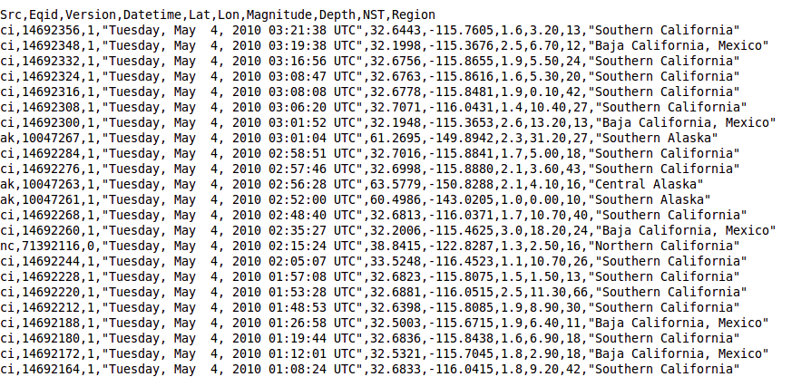
Codified Validations
Aver_{[1,2]}
num_nodes,throughput,raw_bw,net_saturated
- Log file
- CSV
- DB Table
- TSDB
- ...
^{expect}
^{linear(num_nodes, throughput)}
^{when}
^{not net_saturated}
^{expect}
^{throughput >= (raw_bw * 0.9)}
Stage: run.sh ................
Stage: validate.sh ....
[true] check linear scalability
[true] check system throughput
Popper run finished
Status: GOLD
[1]: Jimenez et al. Tackling the reproducibility problem in storage systems research with declarative experiment specifications, PDSW ’15.
[2]: Jimenez et al. I Aver: Providing Declarative Experiment Specifications Facilitates the Evaluation of Computer Systems Research, TinyTOCS, Vol. 3,.

Slide 15
Archiving/DOI service integration
$ popper archive --zenodo --user=ivotron --password=****
Creating archive for repository on Zenodo.
|##############################| 100 %
Your DOI link is: https://zenodo.org/record/1165550

Slide 16



ACM/Popper Badges
Result Status | Artifacts | Re-executed By | ACM | Popper
Repeatability | Original | Original Author(s)
Replicability | Original | 3rd Party
Reproducibility | Re-implemented | Anyone

Slide 17

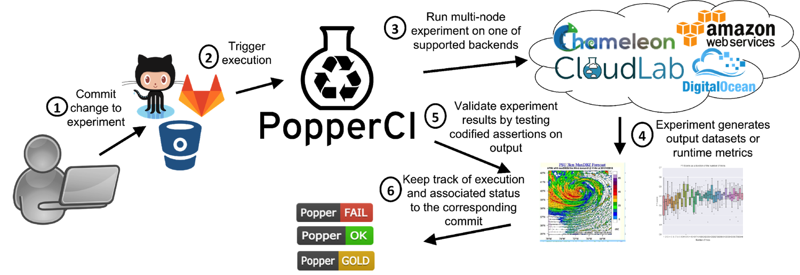


Popper and CI
Push-button Reproducible Evaluation
Notes:
Continuous validation of experimentation pipelines.

